Slide 1
Feedback on Design Thinking Sessions – Residence
Session 15
Presented by Altonjunior Siima
Notes:
Good morning everyone, and thank you for being here today. I’m excited to take you through my
findings from the Residence Design Thinking Workshops and introduce how a user-centric approach
can improve our residence management systems.
This session is about rethinking our current processes through a design thinking lens—one that puts
the needs of students and administrators at the center of our decision-making. Let’s dive in!
>>>>
Before we get into the findings, let’s talk about Design Thinking and why it matters.
What is Design Thinking? It’s a human-centered problem-solving approach that
focuses on understanding user needs, collaboration, and iterative improvements.

Slide 2
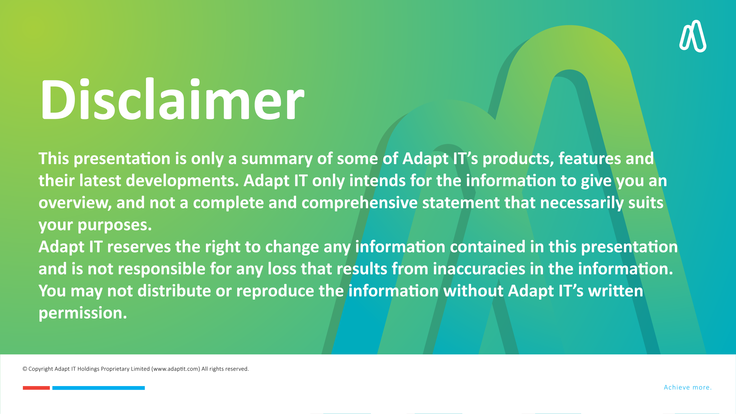
DISCLAIMER
This presentation is only a summary of some of Adapt IT’s products, features and their latest developments. Adapt IT only intends for the information to give you an overview, and not a complete and comprehensive statement that necessarily suits your purposes.
Adapt IT reserves the right to change any information contained in this presentation and is not responsible for any loss that results from inaccuracies in the information. You may not distribute or reproduce the information without Adapt IT’s written permission.

Slide 3

Table of contents
Design Thinking
Pain Points
Using Design Thinking for Solutions
Proposed User-Centric Solutions
Your Thoughts & Comments

Slide 4
Design Thinking

Slide 5
Introduction to Design Thinking
What is Design Thinking?
It’s a human-centered problem-solving approach that focuses on understanding user needs, collaboration, and iterative improvements.
Notes:
Before we get into the findings, let’s talk about Design Thinking and why it matters.
What is Design Thinking? It’s a human-centered problem-solving approach that
focuses on understanding user needs, collaboration, and iterative improvements.
>>>
Why should we adopt this approach? Because user-centric design improves efficiency,
reduces frustration, and leads to smarter decision-making in residence management.
By applying these principles, we can make real, impactful changes in
how residence applications, allocations, and administration work.

Slide 6
Introduction to Design Thinking
Why use User-Centric Design?
Enhances user experience, efficiency, and decision-making in residence management.
Notes:
Why should we adopt this approach? Because user-centric design improves efficiency,
reduces frustration, and leads to smarter decision-making in residence management.
By applying these principles, we can make real, impactful changes in
how residence applications, allocations, and administration work.
>>>>
Here’s what I aim to achieve today:
Apply Design Thinking principles to residence management.
Share key findings and insights from our workshops.
Highlight pain points for students and administrators.
Present user-focused solutions to improve efficiency and transparency.
By the end of this presentation, I want us all to have a better understanding of what’s not working, what needs to change, and how we can fix it together.

Slide 7
Objectives
Apply Design Thinking principles to residence management.
Share key findings and insights from our workshops.
Highlight pain points for students and administrators.
Present user-focused solutions to improve efficiency and transparency.
Outline a clear roadmap for implementation to move forward.
Notes:
Here’s what I aim to achieve today:​
​
Apply Design Thinking principles to residence management.​
​
Share key findings and insights from our workshops.​
​
Highlight pain points for students and administrators.​
​
Present user-focused solutions to improve efficiency and transparency.​
​
By the end of this presentation, I want us all to have a better understanding of what’s not working, what needs to change, and how we can fix it together.​
​
>>>>​
​
Here’s how I’ll structure today’s session:​
​
Design Thinking & User-Centric Design – Why it matters.​
​
Key Findings from the Workshops – What we learned.​
​
Pain Points from Students & Administrators – The challenges.​
​
Applying Design Thinking to Solutions – Possible improvements.​
​
Next Steps & Closing – What’s coming next.​
​
​

Slide 8
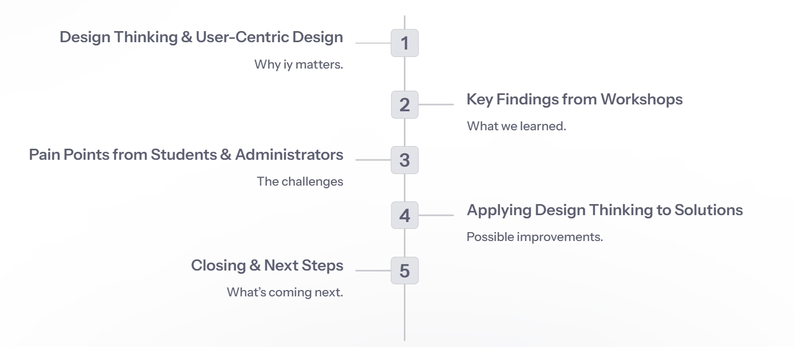
Agenda
Notes:
Here’s how I’ll structure today’s session:​
​
Design Thinking & User-Centric Design – Why it matters.​
Key Findings from the Workshops – What we learned.​
Pain Points from Students & Administrators – The challenges.​
Applying Design Thinking to Solutions – Possible improvements.​
Next Steps & Closing – What’s coming next.​
>>>>>​
​
Applying Design Thinking means that instead of jumping to solutions, we first take a step back and understand the real challenges users face.​
​
We do this through the five phases of Design Thinking:​
​
Empathy – Understand student & administrator frustrations.​
Define – Identify the core challenges.​
Ideate – Brainstorm potential solutions.​
Prototype – Create testable improvements.​
Test – Gather feedback and refine.​
Let’s now look at the key findings that emerged from our workshops.​

Slide 9
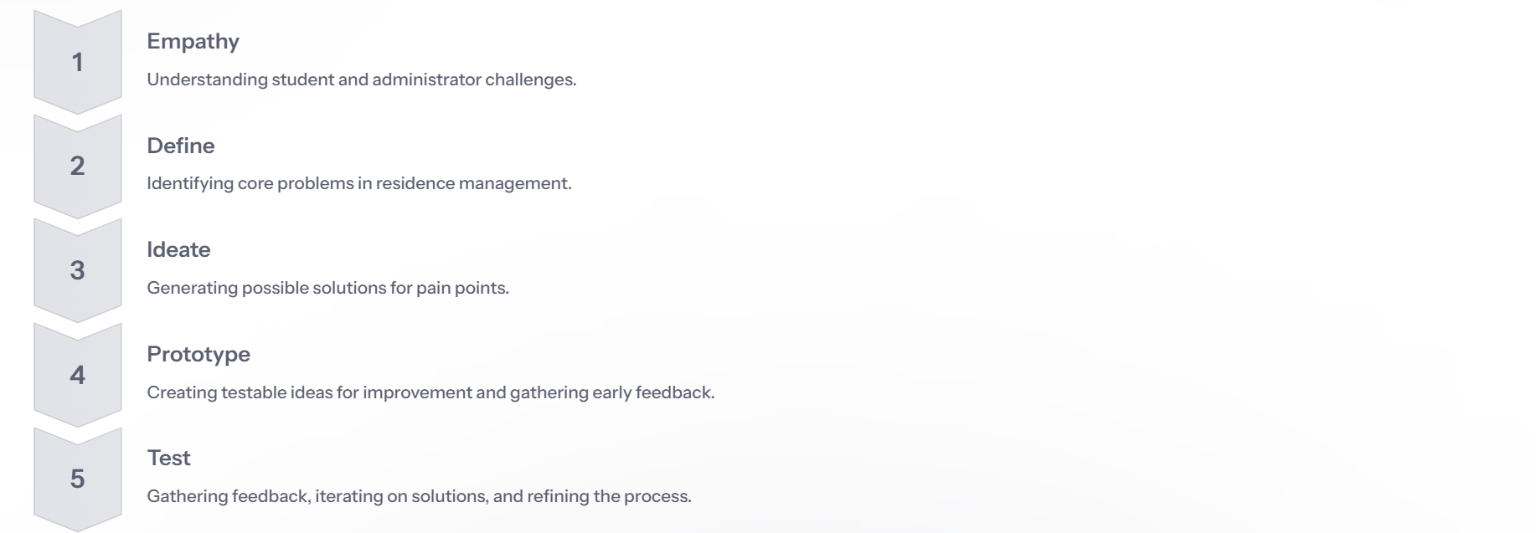
Understanding Residence Management Through Design Thinking
Notes:
Applying Design Thinking means that instead of jumping to solutions, we first take a step back and understand the real challenges users face.
We do this through the five phases of Design Thinking:
Empathy – Understand student & administrator frustrations.
Define – Identify the core challenges.
Ideate – Brainstorm potential solutions.
Prototype – Create testable improvements.
Test – Gather feedback and refine.
Let’s now look at the key findings that emerged from our workshops.
>>>>>
To get a better understanding of the key challenges
We conducted 3 Design thinking workshops with 32 Participants

Slide 10
Overview of Findings from Workshops

Slide 11
Overview of Findings from Workshops
3
32
Client Participants
Client Engagement Sessions
Notes:
To get a better understanding of the key challenges
We conducted 3 Design thinking workshops with 32 Participant
>>>>>>>
Administrators, on the other hand, are dealing with a different set of challenges:
Manual selection & vetting is overwhelming and time-consuming.
No bulk admission processing, making approvals inefficient.
Duplicate applications for multiple academic choices create confusion.
Late applications & NSFAS delays slow down workflows.
Poor system integration between academic and residence platforms.
What this tells us is that both students and administrators need a smarter, automated, and more transparent system.

Slide 12
Pain Points

Slide 13
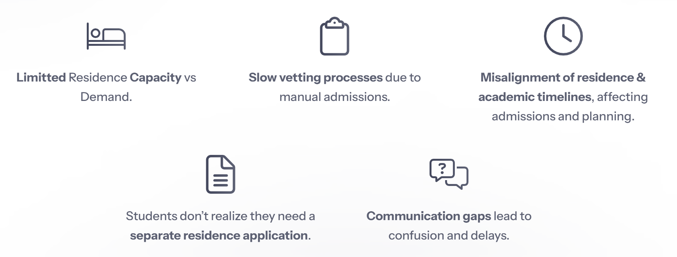
Key challenges impacting residence management
Notes:
The Key challenges impacting residence management:
Residence Capacity vs Demand
Slow vetting processes due to manual admissions.
Misalignment of residence & academic timelines, affecting in-service students.
Students don’t realize they need a separate residence application.
Communication gaps lead to confusion and delays.
These findings highlight why we need a better system—one that is efficient, transparent, and responsive to user needs.
>>>>>
Students shared the following frustrations:
Confusion in the residence application process.
Lack of transparency in how residence allocations are made.
Perceived bias – many feel the system is unfair.
Poor communication – long delays, lack of updates.
No flexibility – they cannot choose preferred residences or roommates.
Clearly, the current system isn’t user-friendly, and it’s affecting student satisfaction and trust in the process.

Slide 14
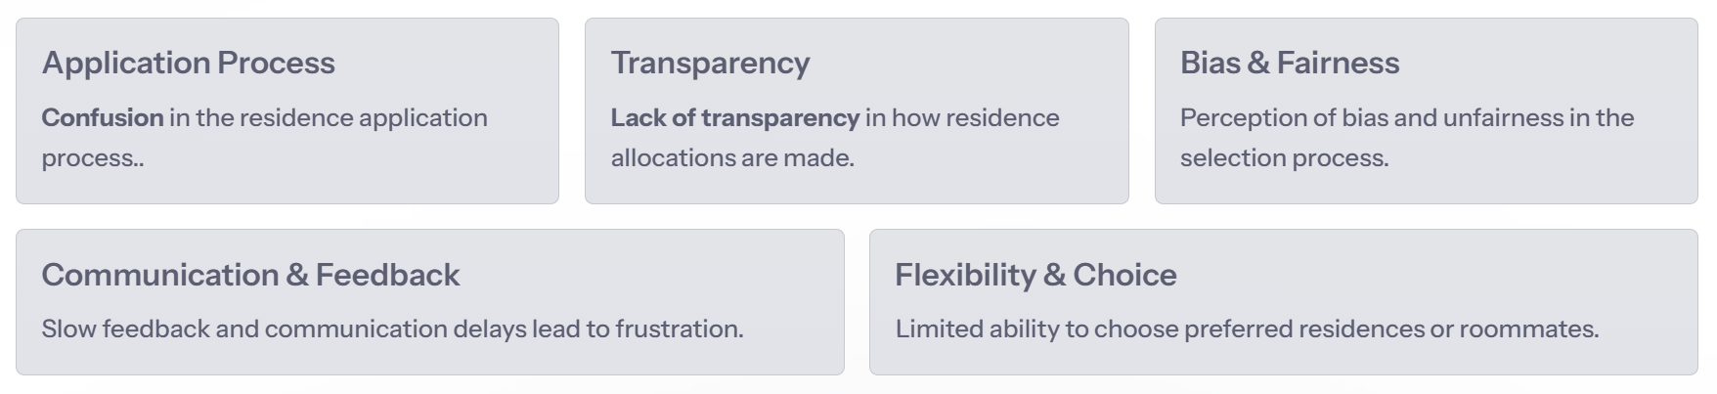
Pain Points from Students
Notes:
Students shared the following frustrations:
Confusion in the residence application process.
Lack of transparency in how residence allocations are made.
Perceived bias – many feel the system is unfair.
Poor communication – long delays, lack of updates.
No flexibility – they cannot choose preferred residences or roommates.
Clearly, the current system isn’t user-friendly, and it’s affecting student satisfaction and trust in the process.
>>>>>
Administrators, on the other hand, are dealing with a different set of challenges:
Manual selection & vetting is overwhelming and time-consuming.
No bulk admission processing, making approvals inefficient.
Duplicate applications for multiple academic choices create confusion.
Late applications & NSFAS delays slow down workflows.
Poor system integration between academic and residence platforms.
Manual linking of documents Students inventory lists are manually linked to the students file.
What this tells us is that both students and administrators need a smarter, automated, and more transparent system.

Slide 15
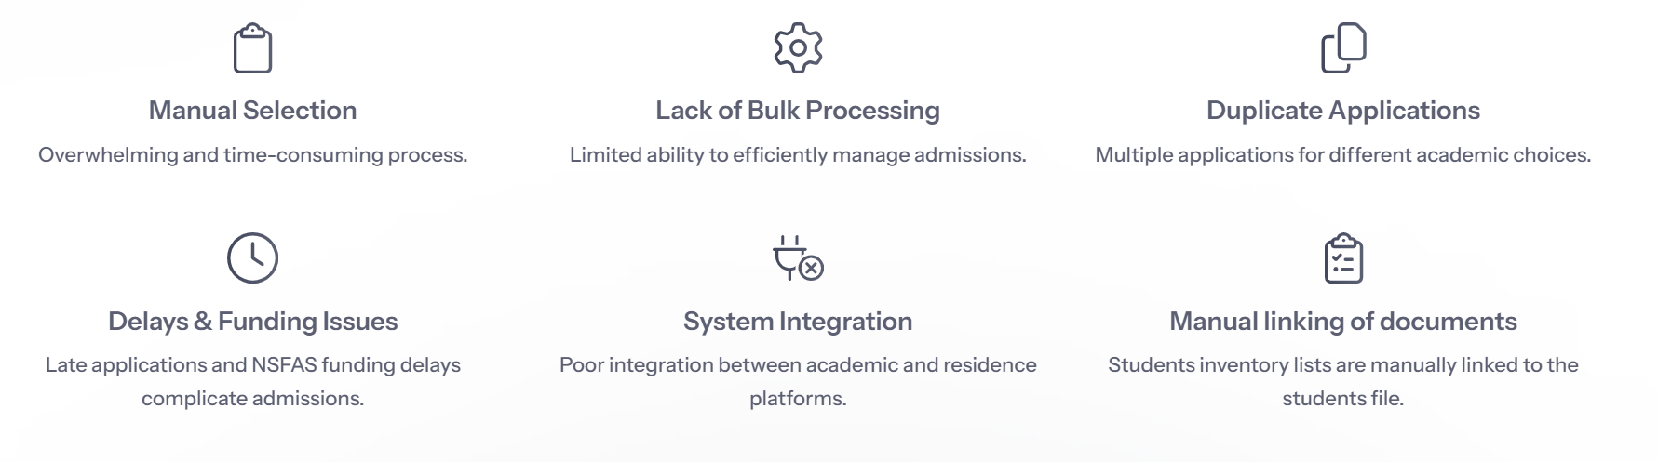
Pain Points from Administrators
Notes:
Administrators, on the other hand, are dealing with a different set of challenges:
Manual selection & vetting is overwhelming and time-consuming.
No bulk admission processing, making approvals inefficient.
Duplicate applications for multiple academic choices create confusion.
Late applications & NSFAS delays slow down workflows.
Poor system integration between academic and residence platforms.
Manual linking of documents Students inventory lists are manually linked to the students file.
What this tells us is that both students and administrators need a smarter, automated, and more transparent system.
>>>>>
Now that we’ve identified the challenges, how do we apply Design Thinking to create solutions?
Empathy – Conduct user research to understand student & staff frustrations.
Define – Map out pain points and create clear workflows to streamline processes..
Ideate – Brainstorm tech-driven solutions that improve automation and integration.
Prototype – Test automated workflows and improvements before implementation..
Test – Continuously gather user feedback to refine and improve the process.
This ensures we design a system that truly meets the needs of users.

Slide 16
Using Design Thinking for Solutions

Slide 17
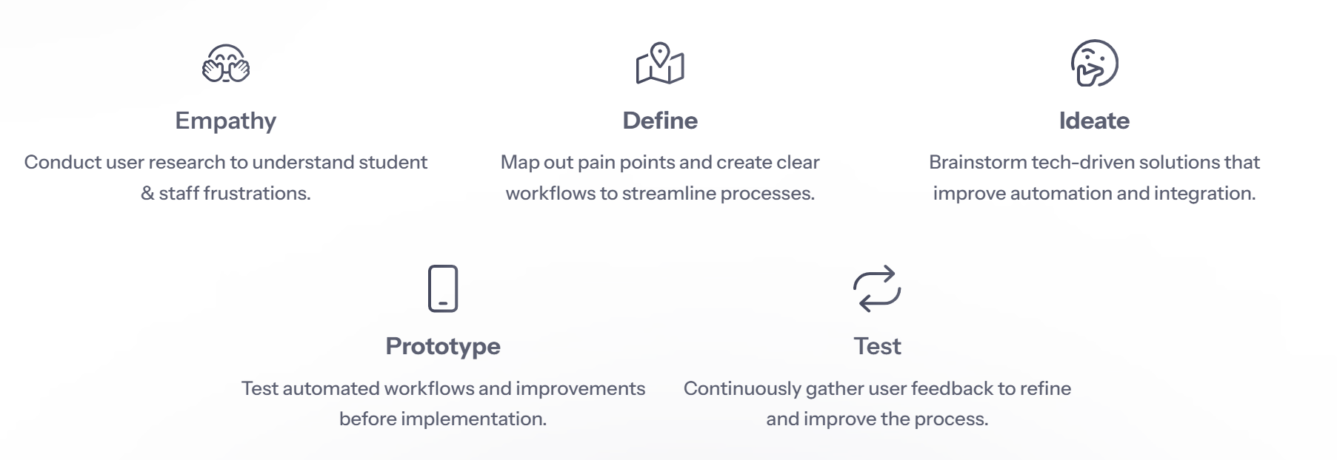
Using Design Thinking for Solutions
Notes:
Now that we’ve identified the challenges, how do we apply Design Thinking to create solutions?
Empathy – Conduct user research to understand student & staff frustrations.
Define – Map out pain points and create clear workflows to streamline processes..
Ideate – Brainstorm tech-driven solutions that improve automation and integration.
Prototype – Test automated workflows and improvements before implementation..
Test – Continuously gather user feedback to refine and improve the process.
This ensures we design a system that truly meets the needs of users.
>>>>>
Here’s how we can improve the residence system:
Automated Vetting & Bulk Admissions – Reduce manual processing delays.
>>
Integrated Academic & Residence Systems – Prevent duplicate applications.
>>
Integrated registration and check-in Streamline the registration and check-in process with an online Assets and Inventory scanner.

Slide 18
Using Design Thinking for Solutions
Notes:
Now that we’ve identified the challenges, how do we apply Design Thinking to create solutions?
Empathy – Conduct user research to understand student & staff frustrations.
Define – Map out pain points and create clear workflows to streamline processes..
Ideate – Brainstorm tech-driven solutions that improve automation and integration.
Prototype – Test automated workflows and improvements before implementation..
Test – Continuously gather user feedback to refine and improve the process.
This ensures we design a system that truly meets the needs of users.
>>>>>
Here’s how we can improve the residence system:
Automated Vetting & Bulk Admissions – Reduce manual processing delays.
>>
Integrated Academic & Residence Systems – Prevent duplicate applications.
>>
Integrated registration and check-in Streamline the registration and check-in process with an online Assets and Inventory scanner.

Slide 19
Proposed User-Centric Solutions

Slide 20
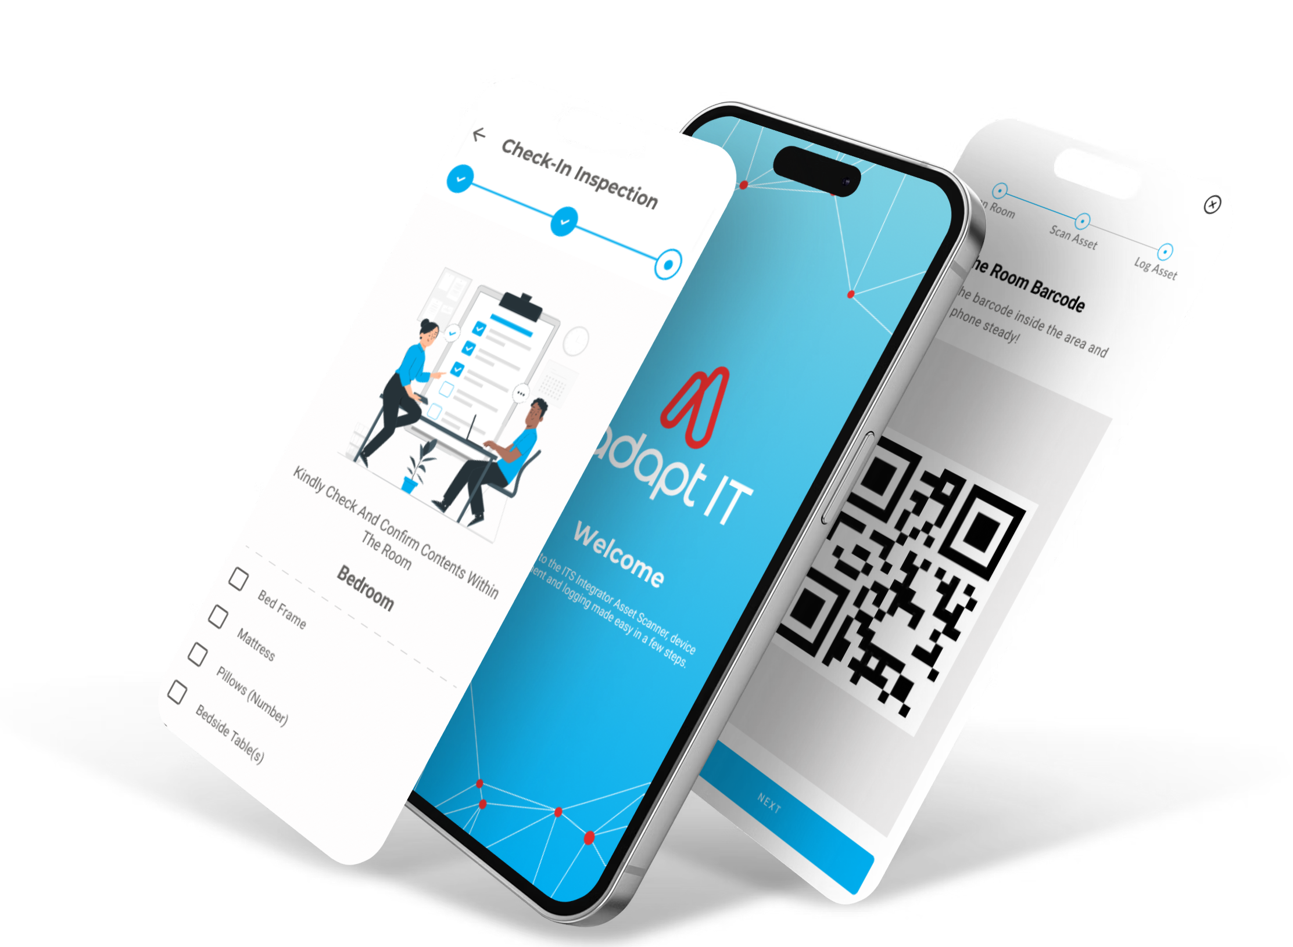
Proposed User-Centric Solutions
Assets & Inventory Scanner
Notes:
Here’s how we can improve the residence system:
Automated Vetting & Bulk Admissions – Reduce manual processing delays.
>>
Integrated Academic & Residence Systems – Prevent duplicate applications.
>>
Integrated registration and check-in Streamline the registration and check-in process with an online Assets and Inventory scanner.
>>>>>
Future concepts residence App

Slide 21
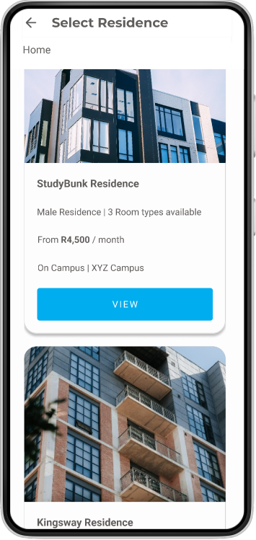
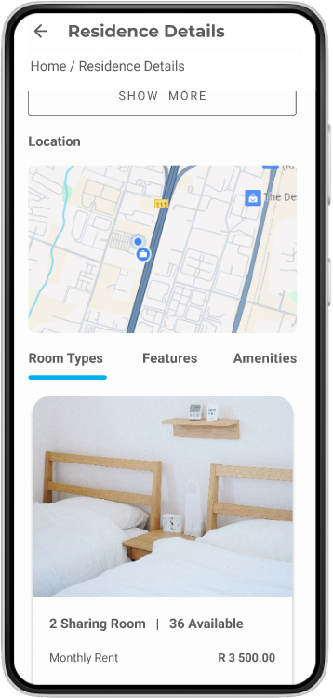
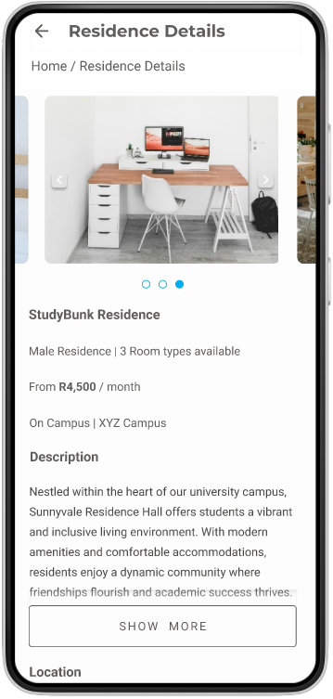
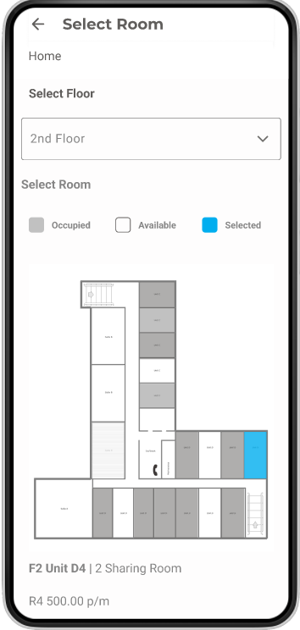
Proposed User-Centric Solutions
Residence App - Currently at Concept Stage
Notes:
​
Future concepts residence App​
​
>>>>​
​
Future concepts residence dashboards​

Slide 22
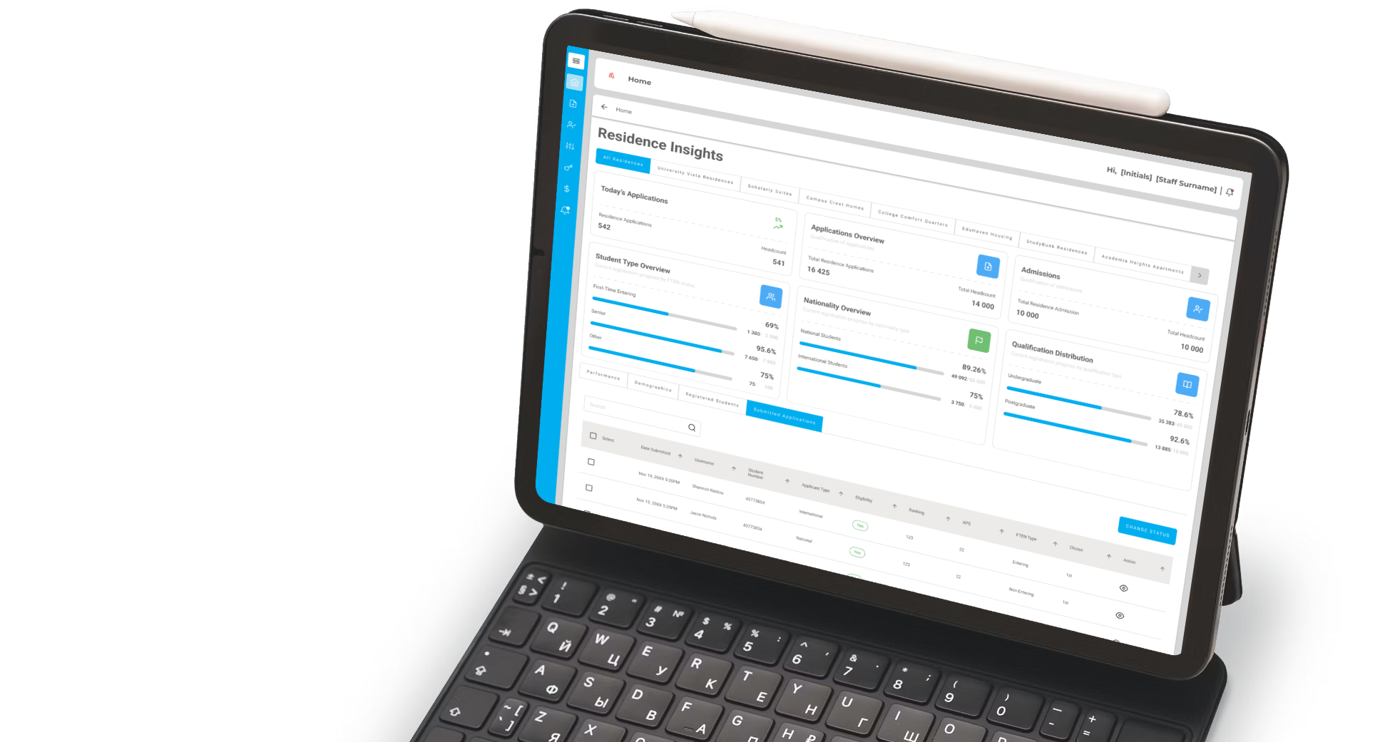
Proposed User-Centric Solutions
Residence Dashboards
- Currently at Concept Stage
Notes:
Here’s how we can improve the residence system:
Automated Vetting & Bulk Admissions – Reduce manual processing delays.
>>
Integrated Academic & Residence Systems – Prevent duplicate applications.
>>
Integrated registration and check-in Streamline the registration and check-in process with an online Assets and Inventory scanner.
>>>>>

Slide 23
Your Thoughts & Comments

Slide 24



